Slide 1
Who needs design patterns anyway?
Toni Petrina
Massive Pixel
@to_pe
toni@massivepixel.co

Slide 2
Agenda
Topic introduction
SOLID
Command pattern
Creation patterns (DI, IoC, Factory)
Organizational patterns
Wrap up

Slide 3
What exactly are patterns?

Slide 4
Definition
A design pattern systematically names, motivates, and explains a general design that addresses a recurring design problem in object-oriented systems. It describes the problem, the solution, when to apply the solution, and its consequences. It also gives implementation hints and examples. The solution is a general arrangement of objects and classes that solve the problem. The solution is customized and implemented to solve the problem in a particular context. Design Patterns by Gamma, Helm, Johnson and Vlissides (360)

Slide 5
When to use them
When it fits
During:
Refactoring
https://github.com/emilybache/GildedRose-Refactoring-Kata/blob/master/csharp/GildedRose.cs
Architecting
https://gist.github.com/lolzballs/2152bc0f31ee0286b722
https://github.com/EnterpriseQualityCoding/FizzBuzzEnterpriseEdition/
interface IHelloWorld{
 | public IHelloWorldString getHelloWorld();
 | public IPrintStrategy getPrintStrategy();
 | public IStatusCode print(IPrintStrategy strategy, IHelloWorldString toPrint);
 | }

Slide 6
SOLID
Single responsibility principle
Open/close principle
Liskov substituion principle
Interface seggregation principle
IReadable, IWriteable instead of IEntity
Dependency inversion principle

Slide 7
How do we teach them?
DRY, YAGNI, KISS, SOLID
Sandi Metz: Duplication is far cheaper than wrong abstraction

Slide 8
Command pattern

Slide 9
// View.xaml <Button Content="Click me" x:Name="btn" />
// View.xaml.cs btn.Clicked += btn_Clicked;

Slide 10
// view.html
<button id="btn">click me</button>
// view.js
$("#btn").click(function () {
//
})

Slide 11
// View.xaml
<Button Content = "Click me" x:Name="btn" />
// ViewModel.cs
class ViewModel
{
public void OnBtn() { }
}
// View.xaml.cs
private ViewModel VM;
btn.Clicked += (_, __) => VM.OnBtn();

Slide 12
// View.xaml
<Button Content = "Click me" x:Name="btn" />
<Button Content = "Click me" x:Name="btn2" />
// View.xaml.cs
private ViewModel VM;
btn.Clicked += (_, __) => VM.OnBtn();
btn2.Clicked += (_, __) => VM.OnBtn2();
// ViewModel.cs
class ViewModel
{
public void OnBtn() { }
public void OnBtn2() { }
}

Slide 13
// Controller
public IHttpActionResult Action(string id, int param)
{
return Ok(service.DoAction(id, param));
}
// Service
public DTO DoAction(string id, int param)
{
using (unit of work)
{ }
}

Slide 14
// View.xaml
<Button Content = "Click me" Command="{Binding OnBtn}" />
// View.xaml.cs
DataContext = new ViewModel();
// ViewModel.cs
class ViewModel
{
public void OnBtn() { }
}

Slide 15
Problems with this approach
Too much coupling
Inability to filter, log, reject, cache commands
Some are cross cutting concerns
How to perform incidental actions
Notifications, logs, validation, cache invalidation

Slide 16
void foo(string url)
{
var client = new HttpClient();
var json = await client.GetString(url);
var model = await Deserialize<Model>(json);
}

Slide 17
async void foo(string url)
{
try
{
var client = new HttpClient();
var json = await client.GetString(url);
var model = await Deserialize<Model>(json);
}
catch (Exception ex)
{
Logger.Log(ex);
}
}

Slide 18
// progress
async void foo(url)
{
if (IsDoing) return;
try
{
IsDoing = true;
var client = new HttpClient();
var json = await client.GetString(url);
var model = await Deserialize<Model>(json);
}
finally
{
IsDoing = false;
}
}

Slide 19
// GA??
async void foo(url)
{
var client = new HttpClient();
var json = await client.GetString(url);
var model = await Deserialize<Model>(json);
GA.SendEvent("did", "something", "now", 1);
}

Slide 20
// throttle?
sendVolumeDownAsync("speaker1");
sendVolumeDownAsync("speaker1");
sendVolumeDownAsync("speaker1");
sendVolumeDownAsync("speaker1");

Slide 21
// ideally
Action foo_final = compose(
validate,
progress,
GA,
foo
);

Slide 22
final foo
try
{
}
catch{}
try
{
}
finally
{
}
GA
foo

Slide 23
Invocation
No direct invocation!
Use pipeline for that
Dispatch(new Command());
We get undo/redo stack for free!

Slide 24
public interface ICommand
{
void Execute();
}

Slide 25
public interface ICommand2
{
bool CanExecute();
void Execute();
}

Slide 26
public interface ICommand3
{
bool CanExecute(object o);
void Execute(object o);
}

Slide 27
public interface IAsyncCommand
{
Task Execute();
}

Slide 28
public class AsyncCommand : IAsyncCommand
{
public async Task Execute()
{
}
}
AsyncCommand cmd;
var t1 = cmd.Execute();
var t2 = cmd.Execute();

Slide 29
public class AsyncCommandNoConcurrent : IAsyncCommand
{
Task task;
public Task Execute()
{
if (task == null)
{
task = Do();
task.ContinueWith(t =>
{
task = null;
});
}
return task;
}
async Task Do() { /* ... */ }
}

Slide 30
public class AsyncCommandOnce : IAsyncCommand
{
Task task;
public Task Execute()
{
if (task == null)
task = Do();
return task;
}
async Task Do() { /* ... */ }
}

Slide 31
Creational patterns

Slide 32
Separate object creation from consumption
DI
replaces new in constructor for unique objects
IoC
replaces new in methods for unique objects
Factory
replaces new for non-unique objects

Slide 33
// DI container
class Container
{
Dictionary<Type, object> cache;
public void Register<TInterface, TClass>(TClass instance)
{
cache.Add(typeof(TInterface), instance);
}
public TInterface Get<TInterface>()
{
return cache[TInterface];
}
}
public class Bar
{
public Bar(IService service = null)
{
this.service = service ?? Container.Get<IService>();
}
}

Slide 34
public class Factory<T>
{
public T Create() => new T();
}
public class FooFactory
{
public Foo Create(int id) => new Foo(id);
}

Slide 35
Why use DI/Factory
For mocking, testing, etc…

Slide 36
public interface IMailSender
{
void Send(string subject, string to, string content);
}
// equivalent to…
public delegate void SendMailDelegate(string subject, string to, string content);

Slide 37
public class Foo
{
public Foo(IService service = null) { }
public void Do() => service.Do();
}
// same as
Action<IService> FooDo =
service => service.Do();

Slide 38
// same as
Action<IService> FooDo =
service => service.Do();

Slide 39
// same as
Action<IService> FooDo =
service => service.Do();
var service = new Service();
Action ServiceDo = () => FooDo(service);

Slide 40
// same as
Action<IService> FooDo =
service => service.Do();
var service = new Service();
Action ServiceDo = () => FooDo(service);
public class Foo
{
public Foo(IService service = null) { }
public void Do() => service.Do();
}
public class Bar
{
public Bar(Foo foo) { this.foo = foo; }
public void Do() { foo.Do(); }
}

Slide 41
public interface IMessageQuery
{
string Read(int id);
}

Slide 42
public class FileStore : IMessageQuery
{
private readonly DirectoryInfo workingDirectory;
public FileStore(DirectoryInfo workingDirectory)
{
this.workingDirectory = workingDirectory;
}
public string Read(int id)
{
var path = Path.Combine(
this.workingDirectory.FullName, $"{id}.txt");
return File.ReadAllText(path);
}
}

Slide 43
Func<DirectoryInfo, int, string> read =
(workingDirectory, id) =>
{
var path = Path.Combine(workingDirectory.FullName, $"{id}.txt");
return File.ReadAllText(path);
};

Slide 44
Func<DirectoryInfo, int, string> read =
(workingDirectory, id) =>
{
var path = Path.Combine(workingDirectory.FullName, $"{id}.txt");
return File.ReadAllText(path);
};
DirectoryInfo root = new DirectoryInfo(Directory.GetCurrentDirectory());
Func<int, string> messageQuery =
(id) =>
{
var path = Path.Combine(root.FullName, $"{id}.txt");
return File.ReadAllText(path);
};

Slide 45
Func<DirectoryInfo, int, string> read =
(workingDirectory, id) =>
{
var path = Path.Combine(workingDirectory.FullName, $"{id}.txt");
return File.ReadAllText(path);
};
DirectoryInfo root = new DirectoryInfo(Directory.GetCurrentDirectory());
Func<int, string> messageQuery2 = id => read(root, id);

Slide 46
const int multiplier = 4.5;
// lambda
Func<int, int, int> calc = (x, m) => x * m;
calc(1, multiplier);
// closure
Func<int, int> calc2 = x => x * multiplier;
Assert.Equal(calc2(1), calc(1, multiplier));

Slide 47
// use closures to fix param
var workingDirectory = new DirectoryInfo(Environment.CurrentDirectory);
Func<int, string> read = id =>
{
var path = Path.Combine(workingDirectory.FullName, $"{id}.txt");
return File.ReadAllText(path);
};

Slide 48
// use closures to fix param
var workingDirectory = new DirectoryInfo(Environment.CurrentDirectory);
Func<int, string> read = id =>
{
var path = Path.Combine(workingDirectory.FullName, $"{id}.txt");
return File.ReadAllText(path);
};
public interface IMessageQuery
{
string Read(int id);
}
Func<int, string>

Slide 49
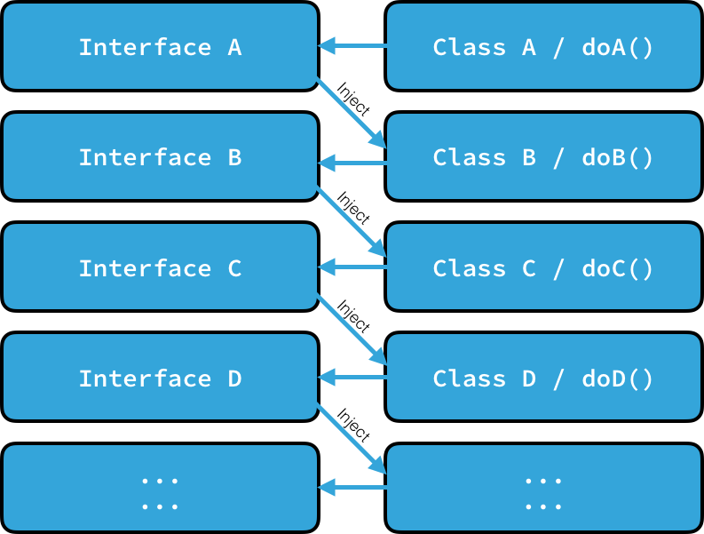

Slide 50
Functional equivalence
public void UpdateStudents(IStudentRepository repo, string name)
{
student.Name = name;
repo.UpdateStudent(student);
}
// So you want to test the above method, but you need to implement
// *EVERYTHING* in repository to make it work

Slide 51
Functional equivalence
public void UpdateStudents(string name, Action<Student> updater)
{
student.Name = name;
updater(student);
}
// So you want to test the above method...
public void TestUpdateStudents()
{
...UpdateStudents("John", _ => { })
}

Slide 52
Organizational patterns

Slide 53
MVC

Slide 54
MVP

Slide 55
MVVM

Slide 56
We have scaling issues

Slide 57
MVVM made simple
http://www.codeproject.com/Articles/278901/MVVM-Pattern-Made-Simple

Slide 58
MVC

Slide 59

User profile page
Compose post
Done
Back
UserProfileViewModel
NewPostViewModel

Slide 62
Redux
View
Action
Reducer
Store

Slide 63
class Counter
{
public int Value { get; set; }
}

Slide 64
class Counter
{
public int Value { get; private set; }
public void inc() { Value++; }
public void dec() { Value--; }
public void set(int val) { Value = val; }
}

Slide 65
// simple store
var store = new Store<int> ((state, action) =>
{
if (action is int) return (int)action;
if (action is string && (string)action == "+")
return state + 1;
if (action is string && (string)action == "-")
return state - 1;
return state;
}, 10);

Slide 66
static Func<Dispatcher, Dispatcher> Log<T>(Store<T> store)
=> next => action =>
{
Console.WriteLine($"Action {action.GetType()} started");
var result = next(action);
Console.WriteLine($"Action {action.GetType()} finished");
return result;
};
var store = Store<int>.CreateStore(
reducer,
initialState,
Store<int>.ApplyMiddleware(Log));

Slide 67
"It's not about the potential power of doing more, it's about exploiting the properties that you gain by doing less."
Cheng Lou

Slide 68
So, who needs design patterns anyway? - All of us!

Slide 69
Questions?

Slide 70
Thank you!

Slide 71
Refactoring to Redux
class Account {
loadAccountInfo (accountId) {
isFetching = true
axios.get(`/api/accounts/${window.userState.accountId}`)
.then(r => {
isFetching = false
data = r.data
})
.catch(e => {
isFetching: false
alert('Error fetching account details')
})
}
}

Slide 72
Refactoring to Redux
loadAccountInfo = (accountId) => {
this.setState({ isFetching: true });
axios.get(`/api/accounts/${accountId}`)
.then(r => {
this.setState({ isFetching: false })
this.setState(r.data)
})
.catch(e => {
this.setState({ isFetching: false })
alert('Error fetching account details'));
})
}

Slide 73
Refactoring to Redux
loadAccountInfo = (accountId) => {
this.setState({ isFetching: true });
axios.get(`/api/accounts/${accountId}`)
.then(r => {
this.setState({ isFetching: false })
this.setState(r.data)
})
.catch(e => {
this.setState({ isFetching: false })
alert('Error fetching account details'));
})
}

Slide 74
Refactoring to Redux
const loadAccountInfo = (accountId) => (dispatch, getState) => {
dispatch({ type: 'ACCOUNT_LOAD_START' });
axios.get(`/api/accounts/${accountId}`)
.then(r => {
dispatch({ type: 'ACCOUNT_LOAD_SUCCESS', data: r.data })
})
.catch(e => {
dispatch({ type: 'ACCOUNT_LOAD_FAIL', data: r.data })
alert('Error fetching account details')
})
}

Slide 75
Refactoring to Redux
const loadAccountInfo = (accountId) => (dispatch, getState) => {
dispatch({ type: 'ACCOUNT_LOAD_START' });
axios.get(`/api/accounts/${accountId}`)
.then(r => {
dispatch({ type: 'ACCOUNT_LOAD_SUCCESS', data: r.data })
})
.catch(e => {
dispatch({ type: 'ACCOUNT_LOAD_FAIL', data: r.data })
alert('Error fetching account details')
})
}

Slide 76
Refactoring to Redux
const reducer = (state = initialState, action) => {
switch (action.type) {
case 'ACCOUNT_LOAD_START':
return {
...state,
isFetching: true }
case 'ACCOUNT_LOAD_SUCCESS':
return {
...state,
isFetching: false }
case 'ACCOUNT_LOAD_FAIL':
return {
...state,
isFetching: false }
}
return state
}
const initialState = {
isFetching: false,
data: null
}

